Slide 1



Java for Android
Part - 2
Ajay Babar

Slide 2

Contents
1 Classes and Objects.
  Object Creation.
  Method Invocation.
  Constructor(method for implicit way of Object creation).
2. Overloading.
  Overloading of Methods.
  Overloading of Constructors.
3. Inheritance
4. Access Modifiers.
5. Overriding.
6. Managing Errors and Exception.

Slide 3
Classes and Objects
1. A class is a collection of fields (data)
and methods(procedure or function) that operate on that
data.
2. By defining the class in Java,
we can create a new data type and we can declare
variables of that type.
For eg : Class classname [extends superclassname] {
    [ field declaration; ]
    [ method declaration; ]
}

Slide 4
class-name
Class Rectangle {
int length;
  int width;
void setData(int x, int y){
length = x;
width = y;
}
int rectArea(){
return length * width ;
}
}
member-variable 1;
member-variable 2;
member-function 1() {
}
member-function 2() {
}
r
Rectangle r = new Rectangle();
Variables
Methods
length
width
setData()
rectArea()

Slide 5
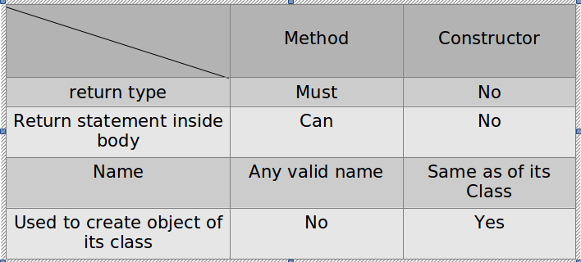
Methods and Constructors
Constructor :
Constructor is used to initialize member variables of the
class at the time of object cretion.
Rectangle(int x) {
length = x;
width = y;
}

Slide 6
Overloading
Two or more methods within the same class and share the
same name; but their parameter declarations or return types
are different.
int getArea(int b, int h) : b * h
Area
double getArea(int b, int h,int val):
b * h * 0.5

Slide 7
Inheritance
Inheritance is the process by which objects of one class
acquire some(or all) properties of another class.
Subclass can access variables and methods defined by
the superclass and can add its own, unique elements.
Vehicle
(Super/Generalization)
Car
(Sub/Specialization)
Truck
(Sub/Specialization)
Sports Car
(Sub)

Slide 8
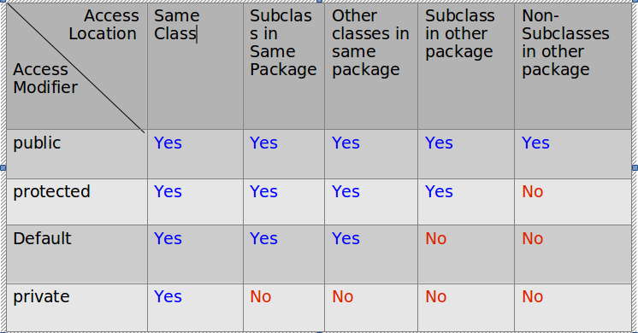
Visibility of Fields in a Class
Access Modifiers

Slide 9
Example of Access modifiers
Package p1
Package p2
Class c1(Super class)
Class c4(Sub class)
int a;
Public int b;
Private int c;
Protected int d;
import p1.c1;
b
d
a
b
d
a
b
import p1.c1;
b
Class c2(Sub class)
Class c3
Class c5

Slide 10
Overriding
Overriding :
  Method in a super class is overridden in the sub
  class.
  The method in the child class will have the same
  signature as that of the super class.
  For e.g.
Class Super {
Void printStuff() {
System.out.println(“A”);
}
}
Class Sub extends Super {
Void printStuff() {
System.out.println(“B”);
}
}

Slide 11
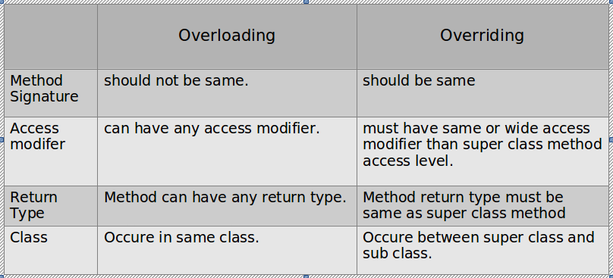
Overloading Vs. Overriding

Slide 12
Errors
Types of Errors :
Errors
Compile-Time
Run-Time
Compile-Time error :
All syntax errors will be detected and displayed by Java
compiler at compile time.
Run-Time error :
Program will be compiled successfully, but may not run
properly due to wrong logic. (e.g. Division by zero)

Slide 13
Exception Handling
Exception :
  Exception is a condition that is caused by a run time error in the program
Exception Handling :
  Provide a means to detect and report;
  an 'exceptional circumstance' so that an appropriate action can be taken.
  Steps to handle exception :
Find problem
Indicate
that
Error has occured
Receive
Error
Information
Take Corrective
action

Slide 14
Syntax of Exception Handling :
...
try {
  Statements ; // generates an exception
  }
  catch( Exception – type e ) {
  Statements ; // process the exception
  }
...

Slide 15
Summary
Defination of class, and creation of object of that class.
Defination of Method and Constructor.
Different Access Modifiers.
Inheritance (Super class and Sub class).
Overload and Override of methods.
Exception Handling.

Slide 16
References
Java 2 The Complete Reference - Herbert Schildt

